Slide 1
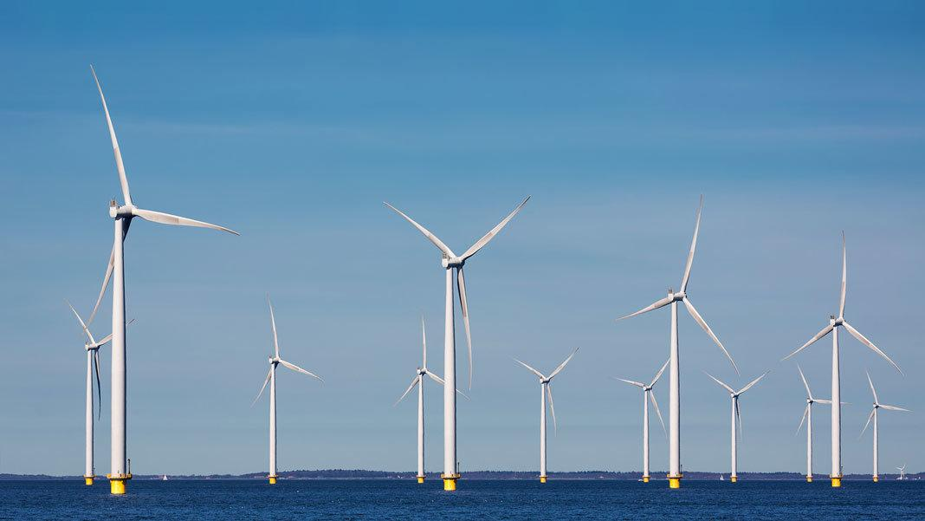
Massachusetts Climate Careers: Powering the Future
Offshore Wind Power and Massachusetts’s Transition to Renewable Energy
Notes:
This lesson will focus on offshore wind power and its role in Massachusetts’s clean energy goals.
We’ll explore the technology, environmental benefits, and a few of the careers related to offshore wind power.

Slide 2
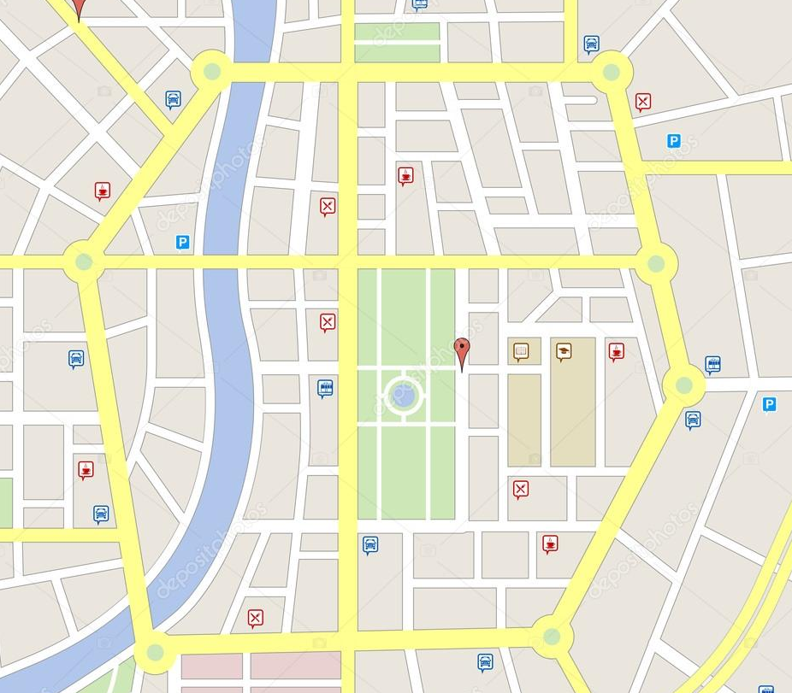
Opening Activity
What criteria would you use to select the best location for building a new entertainment space in town?
Lesson 7: Offshore Wind Power and Massachusetts’s Transition to Renewable Energy
Notes:
Activity objective: Have students connect the identification of certain criteria to decision-making about space and use.
Instructions:
This activity can be done as a large group (as written) or in smaller groups with students debriefing together.
Ask students to suggest ideas for a new space in town: sports stadium, amusement park, movie theater, water park, etc.
Ask students to identify the criteria they would use to determine the best location for this space. For example,
accessibility
size of space
nearby amenities
environmental impact
convenience
Introduce the idea that large energy projects have specific criteria for where they can be successful. For example,
infrastructure
environmental impact
proximity to resources
community impact
efficiency
Location selection is incredibly strategic. Otherwise, offshore wind farms wouldn’t be successful.
Thankfully, because of where we’re located here in Massachusetts, offshore wind power is a big part of our plan to achieve net zero emissions by 2050.

Slide 3
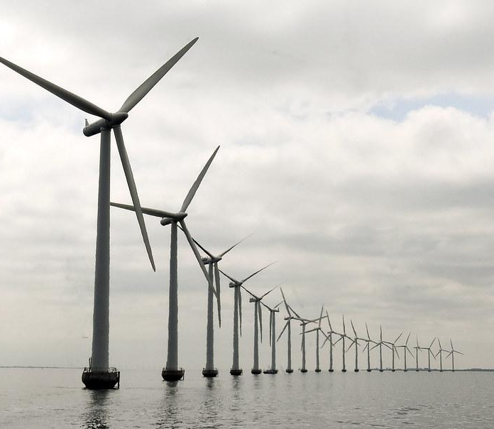
The Big Question and My Climate Goals
Benefits of Offshore Wind Power
Climate Watch and Discussion
Massachusetts’s Ports and Wind Energy
Takeaways and Closing
Lesson 7: Offshore Wind Power and Massachusetts's Transition to Renewable Energy

Slide 4
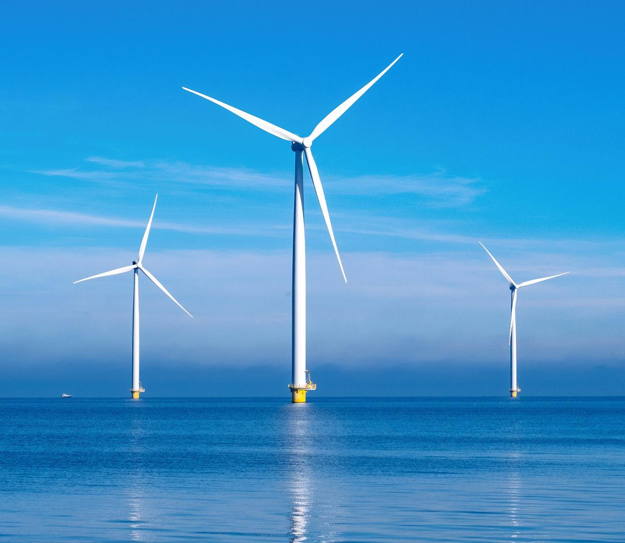
How will large-scale offshore wind projects transform Massachusetts’s energy sources?
Lesson 7: Offshore Wind Power and Massachusetts’s Transition to Renewable Energy

Slide 5
When you complete this lesson, you’ll be able to:
Describe how wind turbines capture energy and convert it into electricity.
Identify examples of climate-critical professionals who work to design, build, and maintain offshore wind farms.
Discuss how Massachusetts’s ports and other infrastructure contribute to the offshore wind industry.
My Climate Goals
Lesson 7: Offshore Wind Power and Massachusetts’s Transition to Renewable Energy

Slide 6
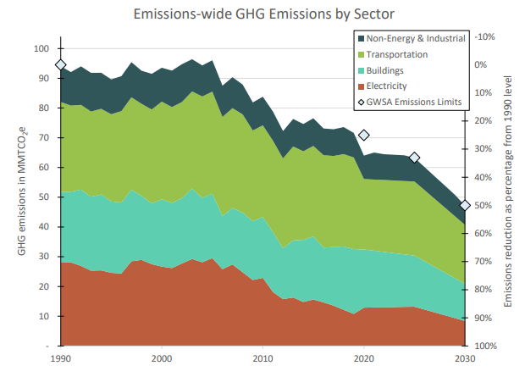
MA Climate Goals
Reduce greenhouse gas emissions by 85% by 2030
Achieve net-zero emissions by 2050
Lesson 7: Offshore Wind Power and Massachusetts's Transition to Renewable Energy
Notes:
By now, students are familiar with MA’s ambitious climate action and energy resilience goals.
These goals rely heavily on electrification; to do that, we need to secure multiple reliable, long-term renewable power sources.
Offshore wind power is an essential part of achieving such goals.

Slide 7
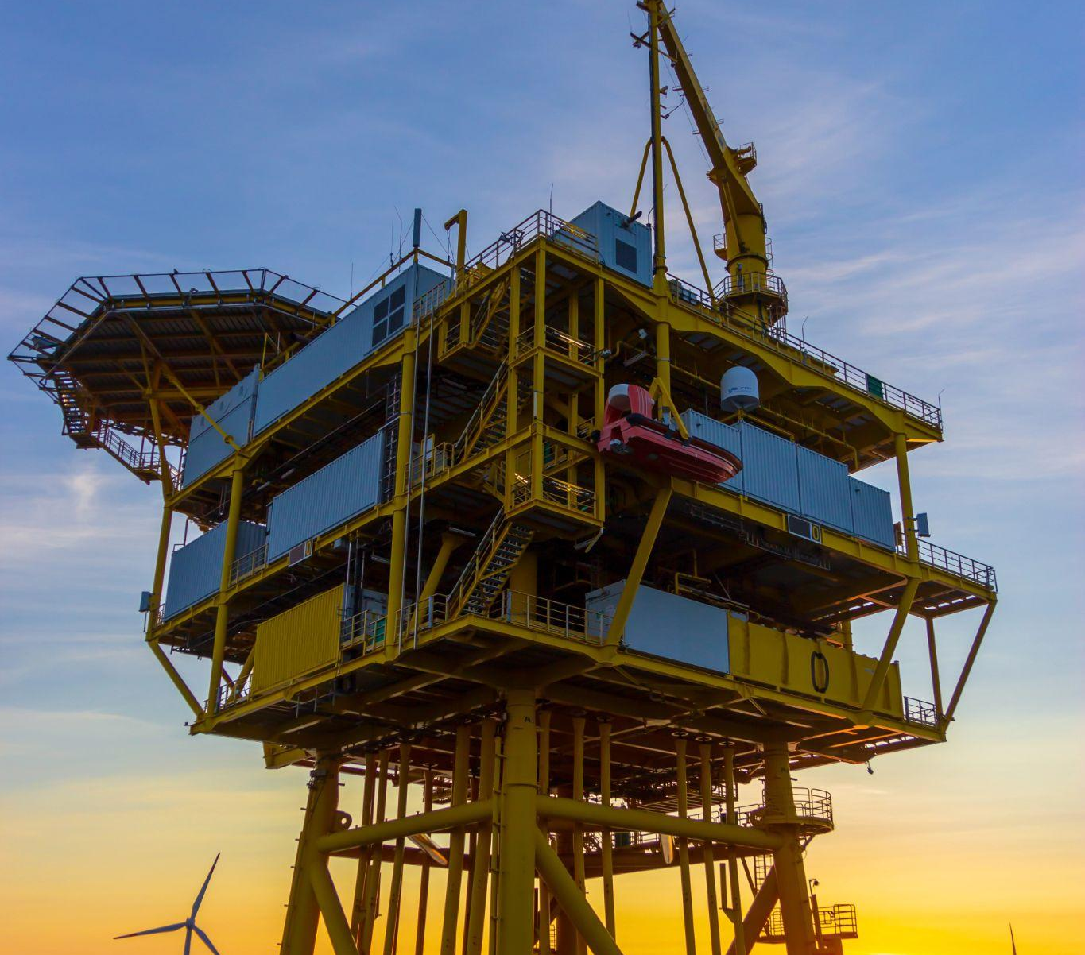
Climate Heroes
Careers in Offshore Wind Projects:
Engineering and design
Construction and installation
Operations and maintenance
Environmental science
Project management and logistics
Lesson 7: Offshore Wind Power and Massachusetts's Transition to Renewable Energy
Notes:
Climate-critical professionals work together to design, build, and maintain offshore wind farms.
Engineering and design: Engineers design, optimize, and build wind turbines and the infrastructure that supports them.
Construction and installation: Construction workers, welders, and crane operators help assemble, transport, and install turbines in offshore locations.
Operations and maintenance: Wind turbine technicians, plant operators, and marine scientists monitor and maintain the equipment to ensure its safety and efficiency. These workers will work on-site or on ships to do this.
Environmental science: Marine biologists and ecologists assess and protect ocean ecosystems surrounding wind farms. They also address any community concerns about the ocean ecosystems.
Project management and logistics: Project managers and logistics specialists oversee project timelines, budgets, and team coordination.

Slide 8
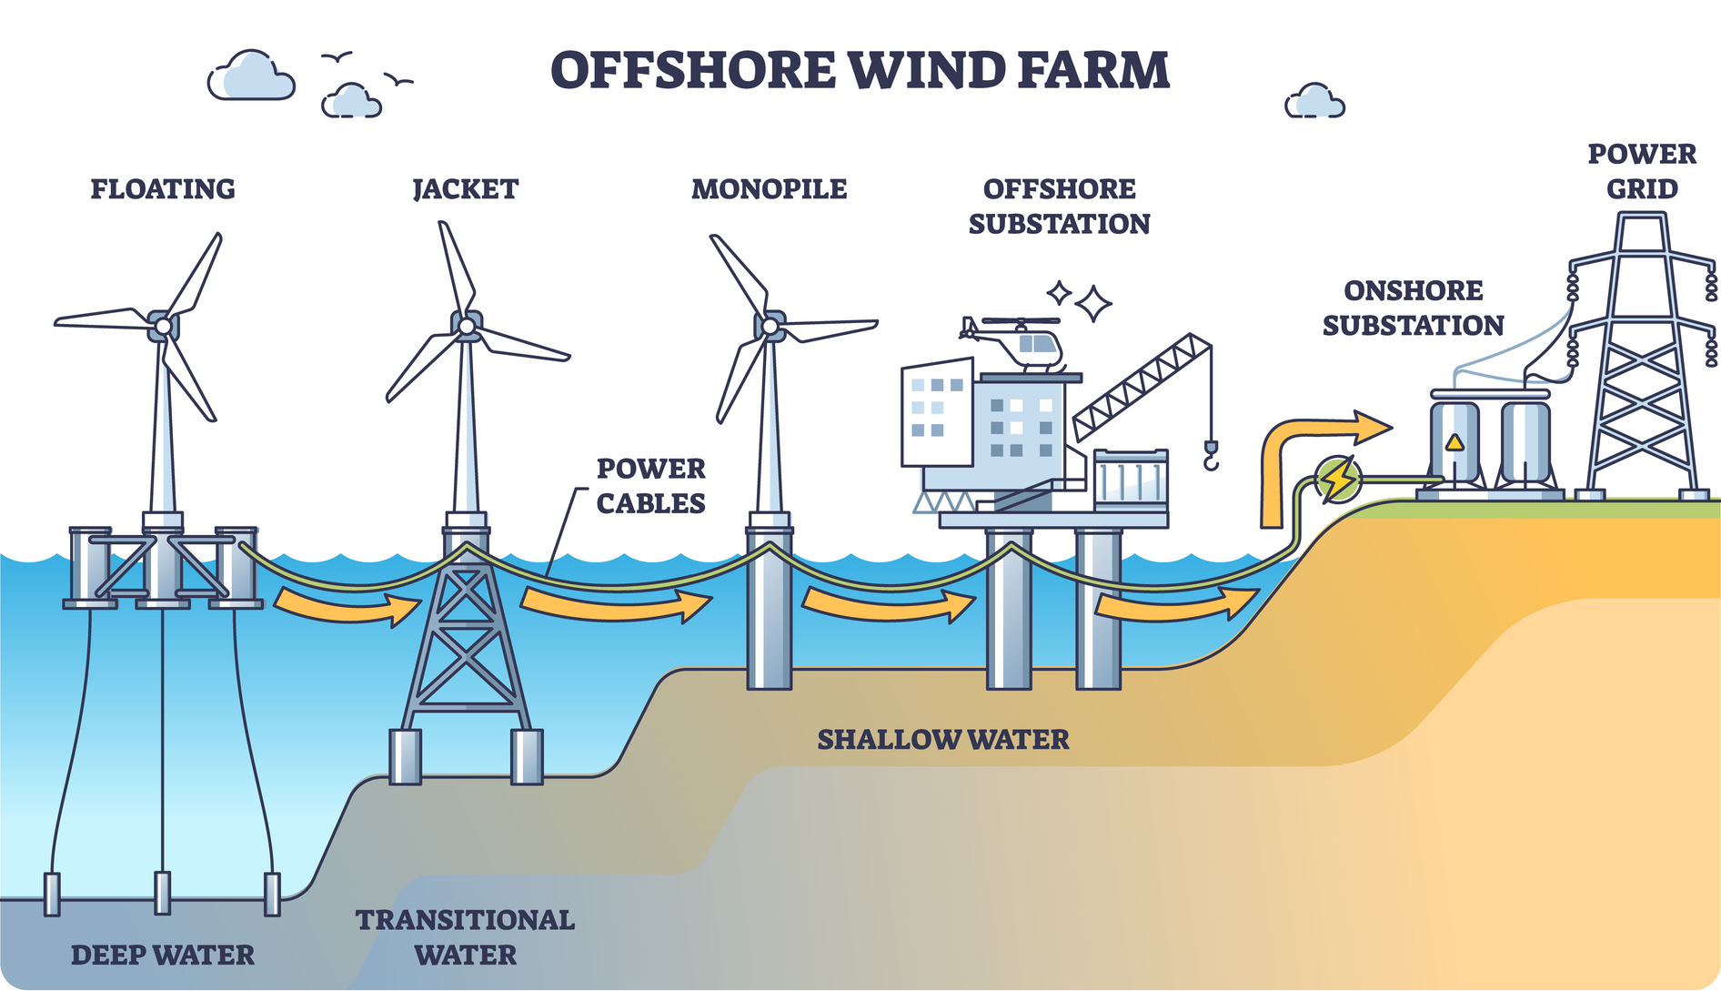
Introduction to Offshore Wind Power
Lesson 7: Offshore Wind Power and Massachusetts's Transition to Renewable Energy
Notes:
Offshore wind power is a clean, sustainable energy source crucial to Massachusetts meeting its renewable energy goals.
Offshore wind energy has significant potential due to the strong, consistent winds over ocean waters, especially compared to the winds over land.
Massachusetts aims to provide 5,600 megawatts from offshore wind farms by 2027—that’s right around the corner!
So how does it work?
Wind turbines capture energy through spinning blades connected to a generator and produce electricity.
Each turbine sends its power through cables down the tower and under the seabed to an offshore substation, where it is adjusted to a higher voltage and sent to shore through high-voltage cables.
Once it reaches shore, it is adjusted to an even higher voltage to be fed into the grid and distributed to homes and other buildings via power lines.

Slide 9
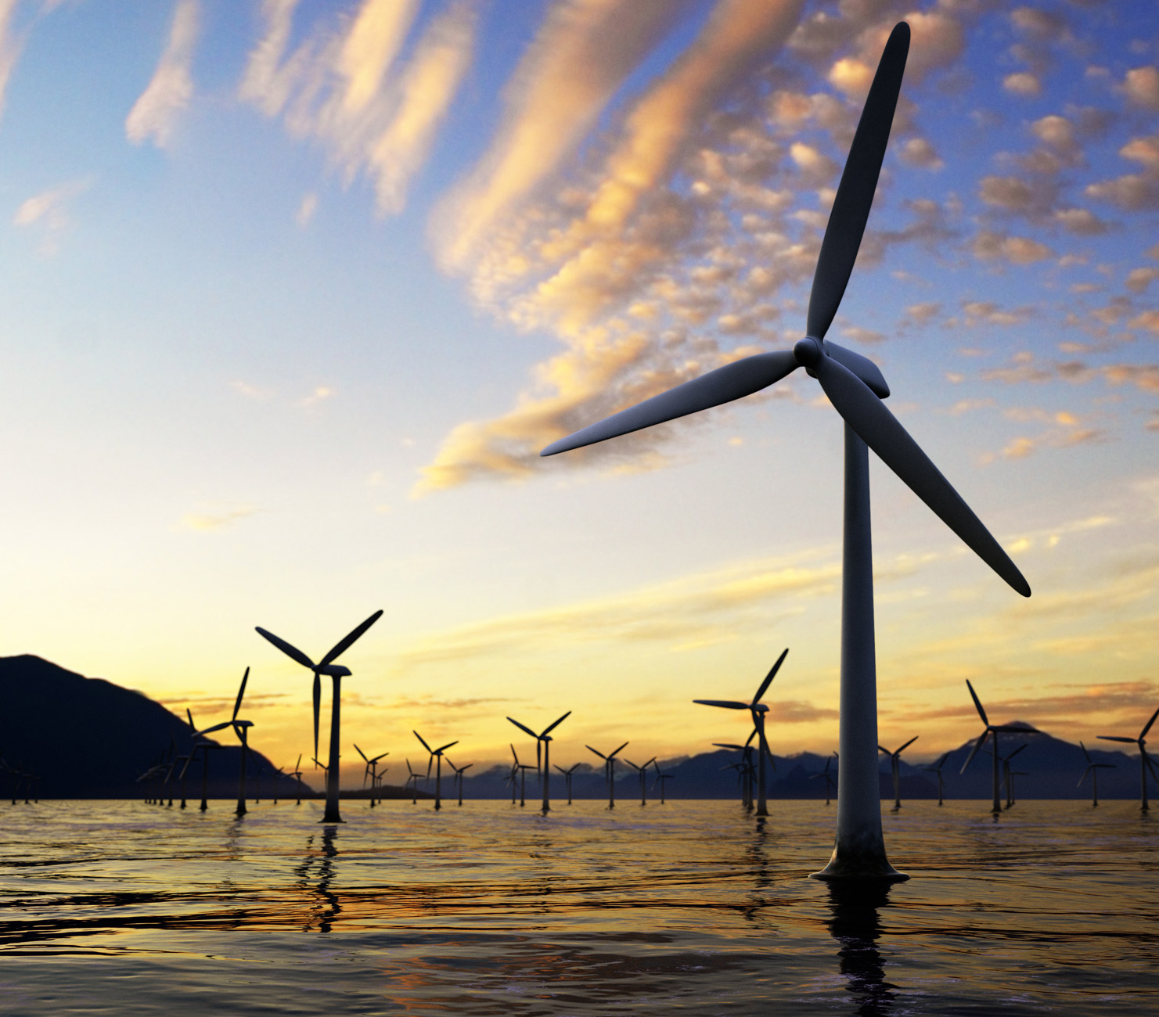
Environmental Benefits
Reduces greenhouse gas emissions
Decreases air pollution
Sustainable resource with long-term potential
Energy can be stored for later use
Lesson 7: Offshore Wind Power and Massachusetts's Transition to Renewable Energy
Notes:
Offshore wind power lessens reliance on fossil fuels, producing cleaner air and reducing greenhouse gas emissions.
Lowers GHG: Wind energy produces no carbon dioxide or other greenhouse gases, helping to combat climate change.
Decreased air pollution: Wind turbines generate electricity without emitting any pollutants, leading to cleaner air, which contributes to improved public health
Sustainable resource: Wind is abundant, especially offshore. Offshore wind power is, therefore, a sustainable solution for long-term energy needs.
Energy storage systems allow a more stable and reliable energy supply from renewable sources, further lowering reliance on fossil fuels.

Slide 10
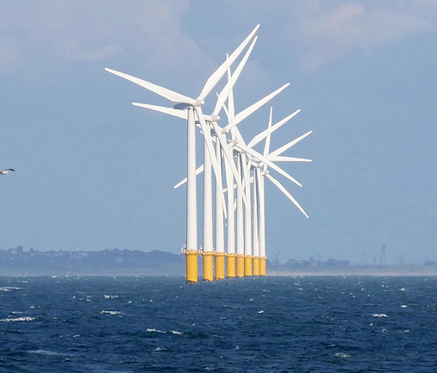
Community Benefits
Creates jobs in manufacturing, installation, and maintenance
Stabilizes energy prices
Attracts investment opportunities
Strengthens the resiliency of the energy grid
Lesson 7: Offshore Wind Power and Massachusetts's Transition to Renewable Energy
Notes:
There are many benefits for communities, including economic and security gains.
Job creation: The wind energy industry creates jobs in manufacturing, installation, maintenance, and support services, benefiting both local and national economies.
Wind energy helps stabilize energy prices by reducing reliance on fossil fuels, which are subject to market volatility and the actions or priorities of other nations.
Wind energy projects attract investments in infrastructure, technology, and local economies, resulting in growth and development. Locally, this can lead to more benefits, such as land lease payments, tax revenue, or further community investments.
Wind energy systems can be built decentralized, spreading out over a larger area. This makes the grid more resilient against disruptions and helps reduce the risk of large-scale power outages.
Ask students about other benefits of offshore wind power beyond what has already been shared here.
Technological advancements
Energy security
Energy storage
Community education, broader community support from “not in my backyard” (NIMBY) folks

Slide 11
Wind Testing Technology Center
Lesson 7: Offshore Wind Power and Massachusetts's Transition to Renewable Energy
Notes:
This video is included for additional content, and can be skipped if needed for time.
The Wind Testing Technology Center (WTTC) in Boston is a world-class facility where engineers test and improve wind turbine blade technology, especially for offshore wind farms.
Turbine blades capture wind energy through aerodynamics. Their curved design causes air to move faster over one side than the other. This creates lift—similar to an airplane wing.
This lift spins the blades, converting kinetic energy (the power of movement) into mechanical energy. A generator connected to the blades turns mechanical energy into electricity.
At the WTTC, engineers work to build larger, stronger, and more efficient blades.
Larger blades can capture wind and create electricity, even in low-wind conditions.
They also test new materials. Carbon fiber is lightweight and robust, potentially offering superior durability in offshore conditions compared to older materials.

Slide 12
Climate Watch:Video
Video coming soon
Courtesy XXXXXX
Lesson 7: Offshore Wind Power and Massachusetts's Transition to Renewable Energy
Notes:
Video coming by Spring 2025.
The video will feature https://www.nbfossmarineterminal.com/

Slide 13
What impact do you think the wind terminal will have on residents who live nearby?
How might this affect Massachusetts residents who live outside of New Bedford?
Climate Watch Discussion
Lesson 13: Lineworkers
Notes:
We have one of the world’s leading offshore wind farms right in our backyard.
What impact do you think the wind terminal will have on nearby residents?

Slide 14
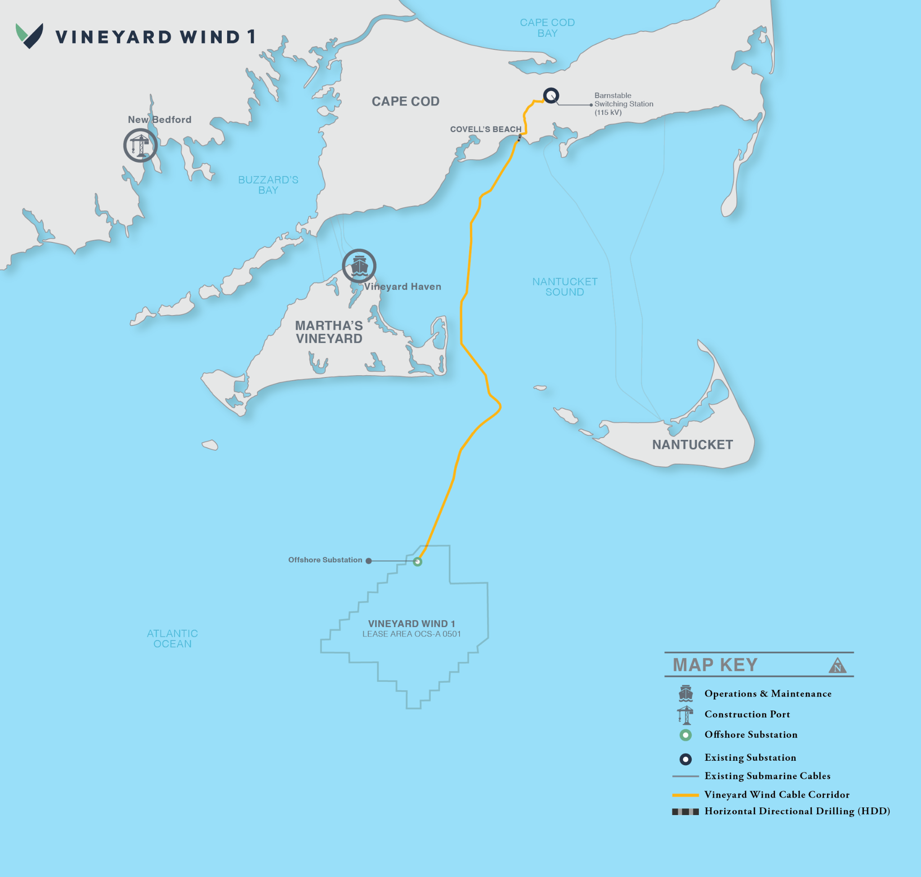
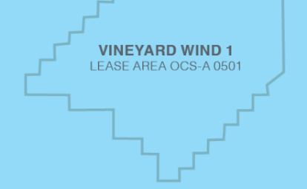
MA Ports and
Wind Energy
Barnstable
Switching Station(115 kV)
Vineyard Haven
New Bedford Wind Terminal and Salem Offshore Wind Terminal features:
Heavy-duty wharves with heavy-lift capacity
Reinforced storage and assembly space
Deep water berths and dredging capability
Offshore Substation
VINEYARD WIND 1
Lease Area OCS-A 0501
Image source: Vineyard Wind 1 Project
Lesson 7: Offshore Wind Power and Massachusetts's Transition to Renewable Energy
Notes:
Massachusetts is a coastal state, and we have a lot of coastline.
However, not all ports along the coast work well for the offshore wind industry.
Both New Bedford and Salem have recently undergone upgrades that allow them to support offshore wind projects nearby, so they have both been selected to participate in the Vineyard Wind 1 Project.
They both have features that allow wind farm components to be manufactured and transported through their wharves.
Ask students why these features are essential when selecting a site for offshore wind farms.
Heavy-duty wharves can handle heavy equipment and large components, such as tower racks or turbine foundations.
Lay-down areas are essential for storing and assembling large turbine components weighing over 2,800 tons. These spaces must be reinforced to support such weight.
Dredging allows access for specialized construction or maintenance boats.
The two ports will not be used in the same way.
The New Bedford Marine Commerce Terminal will support the construction, assembly, and deployment of offshore wind projects and handle bulk, break-bulk, container shipping, and large specialty marine cargo.
The Salem Marine Terminal is under construction and will serve as a logistics and operations center for turbine pre-assembly, transportation, staging activities, and assembly component storage.

Slide 15
How could other historic ports support offshore wind?
In groups, you will:
Evaluate your assigned port.
Determine the likelihood of this port being used in future projects.
Identify necessary upgrades.
Present your findings to the class.
Group Activity
Lesson 7: Offshore Wind Power and Massachusetts's Transition to Renewable Energy
Notes:
Activity objective: Analyze several Boston ports and determine their feasibility for supporting future offshore wind projects. Reinforce students’ understanding of key infrastructure needs and the role of strategic planning in renewable energy development.
Instructions:
Divide students into groups and assign each group one of the four ports listed on their worksheets: Charlestown Navy Yard, Mystic River Terminal, Conley Terminal, or East Boston Terminal.
Briefly review the criteria for offshore wind projects included in the student worksheets (depth, heavy-duty wharves, lay-down areas, proximity, and environmental impact).
In groups, students will review the details provided about their assigned port and determine the following:
How well does the port meet the provided criteria for offshore wind project support?
What upgrades or improvements would be necessary to make the port more suitable?
Are there additional ways the port could support clean energy projects (e.g., energy storage, solar, or workforce development hubs)?
During the debrief discussion, each group will give a brief (1 minute) presentation on their assigned port and share their findings with the class.

Slide 16
Activity Debrief
How does this exercise help us answer today’s Big Question:
How will large-scale offshore wind projects transform Massachusetts's energy sources?
Lesson 7: Offshore Wind Power and Massachusetts's Transition to Renewable Energy
Notes:
Debrief discussion:
How will large-scale offshore wind projects transform Massachusetts's energy sources?
Which port do you think has the most potential for supporting offshore wind projects, and why?
What are some of the common challenges that ports face in becoming suitable for offshore wind infrastructure? How might these challenges be overcome?
How can ports like the ones we evaluated contribute to Massachusetts's broader clean energy goals?

Slide 17
Wind turbines convert wind energy into electricity.
Offshore wind projects support Massachusetts's clean energy and economic goals.
Ports such as New Bedford and Salem are vital to the offshore wind industry.
Lesson 7: Offshore Wind Power and Massachusetts's Transition to Renewable Energy
Notes:
Wind energy and the infrastructure that supports it play a critical role in Massachusetts’s clean energy future.

Slide 18
Closing Activity
Reflect on today’s lesson for one minute, then answer the following questions:
What did you learn about offshore wind power today that surprised you?
Why are Massachusetts's ports so important to the offshore wind industry?
Lesson 7: Offshore Wind Power and Massachusetts's Transition to Renewable Energy

Slide 19
This Photo by Unknown Author is licensed under CC BY-ND

